Slide 1
Designing a Plug-In Measurement Abstraction
Layer Using the Actor Framework
Elijah Kerry, Certified LabVIEW Architect (CLA)
Senior Product Manager for LabVIEW, National Instruments
Notes:
Abstract: Examine the technical design decisions made while developing a multiprocess plug-in measurement system. One of the goals of this system is to minimize the level of effort required to add functionality to a relatively complex system through the use of a plug-in architecture, which is an increasingly popular request among LabVIEW programmers looking for ways to design extensible applications. At this session, dive into the technical details of using the Actor Framework, decoupling independent components, distributing templates, and deploying these plugins for the purpose of calling them from an executable.
I’ve been working with customers developing large applications for years, and I’ve noticed several trends in the types of questions and the systems our users are building. What you’ll see today was my attempt to examine some of those especially technically challenging questions in order to evaluate how to implement them.

Slide 2
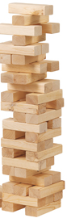
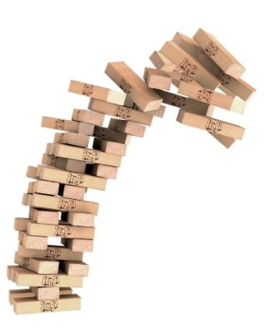
Does this sound familiar?
Adding or changing support for hardware requires significant effort and time.
You’re constantly copying and duplicating code to add similar, but different functionality.
Adding new functionality breaks code due to brittle design.
Scalable Modular Reusable Extensible Simple
Notes:
This should be fairly self-explanatory, but emphasize that our goal is to balance all of these criteria as we make design decisions about our code and our application.
Scalable – you have 3 menu items, now you need 4 – how tedious is this process? Same goes for hardware.. Either way, It means your code probably wasn’t very scalable.
Modular –You’ll know you haven’t done this if it becomes impossible to extract a component from an application or when changing someone in component A breaks something that is completely un-related in component B.
Reusable - if you know that you’re going to need duplicated functionality in multiple applications or even in different pieces of the same application, it’s important to design it to be reusable. A key example of that is instrument drivers. This obviously hinges upon modularity – the reusable components should be modular and separate from any unrelated functionality
Extensible – ever run into a scenario when a new feature means ‘refactoring’ or even starting over? It means your code probably wasn’t very extensible.
Simple – Engineers have a natural instinct to over-engineer solutions (sometimes). Thoroughness is good, but sometimes, simple is better.

Slide 3
Primary Goals
Define an architecture that allowed other developers to add functionality (ie: ‘plugins’) without modifying the calling framework
Determine the best way to give people writing plugins starting points that included the necessary APIs, parent classes, and stub code in order to minimize the work required
Develop a strategy to deploy the framework as an executable and manage common dependencies of those plugins appropriately
Explore the implementation of a hardware abstraction layer, or HAL, which quickly also led to the creation of a measurement abstraction layer, or MAL
Notes:
Here are some of the more dominant themes that drove the design decisions I made for this architecture. Think of these as high level requirements for the system

Slide 4
Secondary Goals
Understand how to compartmentalize code for the sake of enabling large teams of developers
Explore the mechanisms for managing communication amongst multiple dynamically-spawned, free-running processes
Package and distribute source code for the sake of reuse
Enable the plugins to be installed (or even uninstalled) separately from the deployed copy of the framework
Notes:
These high level requirement led to secondary goals that I quickly realized would be necessary in order to satisfy some of the requierments I just showed

Slide 5
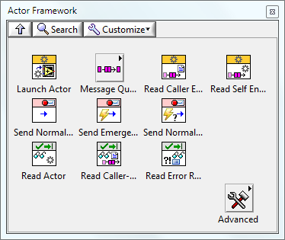
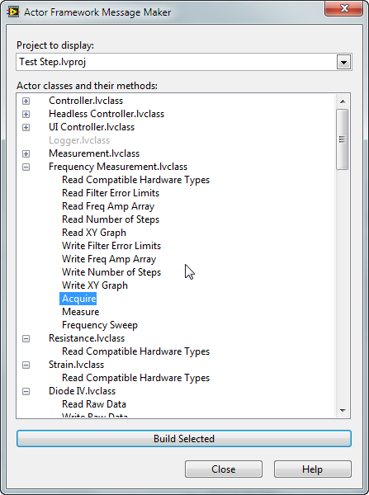
Framework for Large, Multi-Process Systems
The Actor Framework is designed for large multi-process applications
Includes utility for generating messages and invoking actor methods
For more information:
ni.com/actorframework
Makes heavy use of object-oriented programming in order to eliminate duplication of code and improve system scalability
Notes:
From an architectural perspective, this particular implementation heavily leverages the actor framework as the solution to the large, multiprocess, asynchronous requirement While this session is not a lesson on AF, here’s a quick recap.

Slide 6
Creating a Multi-Process System
Best Practices
Identify data scope
Delegate actions to appropriate process
Do not poll or use timeouts*
*except for code that communicates with hardware
Considerations
How do you send commands?
How do you send data?
Which processes can communicate with each other?
How do you update the UI?
Event-Driven Loop
DAQ Application
Notes:
Many systems have multiple loops, and there are some general best practices for a multi-loop system. The need for the actor framework arises, however, when you have a very large number of independent loops that are all either doing the identical task or just ever so slightly different tasks.

Slide 7
Use Case for the Actor Framework
Queue References
Use the Actor Framework to scale numerous different, but similar consumer loops
Traditional Solution: Dynamically load VI or duplicate code
Notes:
As they scale, there are several challenges with managing communication and avoiding code duplication. We also want to minimize the work required to add new functionality to the system.
These are actors – conceptually, for those of you not familiar with the AF, they are just QMHs.

Slide 8
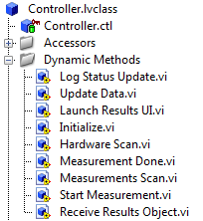
Methods of an Actor are run when a message is received
Log Status Update
Update Data
Launch Results UI
Initialize
Hardware Scan
Measurement Done
₌
Measurement Scan
Start Measurement
Receive Results Object
Methods of an Actor define the messages it can consume
Notes:
The key difference though is that instead of representing the commands the QMH can receive as cases in a while loop, we represent them as the methods of a class (ie: our actor).
Why is this valuable? Well, we can instantiate multiple instances of a class (aka objects), and….

Slide 9
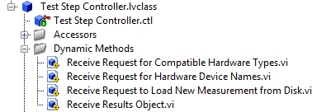
Methods of an Actor are run when a message is received
Log Status Update
Update Data
Launch Results UI
Initialize
Hardware Scan
Measurement Done
₌
Measurement Scan
Start Measurement
Receive Results Object
Receive Results Object
Overridden
Receive Request for Compatible Hardware Types
Receive Request for Hardware Device Names
Receive Request to Load New Measurement from Disk
Notes:
We can override and extend the methods of a class – so we’re able to add or even change functionality of our QMH with zero code duplicaiton.

Slide 10
Measurement System Class Hierarchy
Actor
Controller
User Interface
Measurement
Results
Test Step Controller
Operator UI
Strain
Resistance
Diode I-V
Frequency Curve
Voltage
Notes:
So these are the actors in this system. Quick explination of each. Think of this as a crude form of UML: we’re seeing the class hierarchy of our system.

Slide 11
Test Step Task Tree
Task Tree
Controller Actor
User Interface
Measurement
Result
Notes:
However, class hierarchy is not synonymous with calling hierarchy. One of the tenants of this design was to have highly decoupled components. As you can see here, the controller is what spins everything in this system up and calls the other components. To be clear, the other three components never interact directly with one another.

Slide 12
Test Step
Initialize.vi
Initialize Msg.lvclass
Launch UI Msg.lvclass
Launch UI.vi
User Interface
Launch UI Actor
HW Scan.lvclass
Hardware Scan.vi
Initialize.vi
Msmt Scan.lvclass
Msmt Scan.vi
Disp Msmt.vi
Msmt Selected
Initialize Msg.lvclass
Get HW Info.vi
Matching HW.vi
Request HW Msg.lvclass
Available HW Msg.lvclass
Display Hardware.vi
HW Selected
Validate Selection.vi
Check Validty.vi
Notes:
And finally, this illustrates the behavior of this system.

Slide 13
Test Step
Initialize.vi
Initialize Msg.lvclass
Launch UI Msg.lvclass
Launch UI.vi
User Interface
Launch UI Actor
HW Scan.lvclass
Hardware Scan.vi
Initialize.vi
Msmt Scan.lvclass
Msmt Scan.vi
Disp Msmt.vi
Msmt Selected
Initialize Msg.lvclass
Get HW Info.vi
Matching HW.vi
Request HW Msg.lvclass
Available HW Msg.lvclass
Display Hardware.vi
HW Selected
Validate Selection.vi
Check Validty.vi

Slide 14
HW Selected
Validate Selection.vi
Check Validty.vi
Run Pressed
Send Run Rqst.lvclass
Send Run Request
Start Msmt.vi
Launch Msmt Msg.lvclass
Measurement
Launch Measurement
Checkout HW.vi
Initialize.vi
Config Msmt Msg.lvclass
Configure.vi
Acquire Msg.lvclass
Acquire.vi
Measure Msg.lvclass
Measure.vi
Send Results Msg.lvclass
Receive Results.vi
Close.vi
Stop Msmt Msg.lvclass
Display Results.vi
Display Results Msg.lvclass
Checkin HW.vi

Slide 15
Demonstration
Brief walk-through of Measurement System
Notes:
Now that you have a fundamental understanding of the system, lets run it and take a look at some of the block diagrams of the methods we just saw.
Demo: run system, execute a few basic measurements

Slide 16
Measurement System Class Hierarchy
Actor
Controller
User Interface
Measurement
Results
Test Step Controller
Operator UI
Statically linked
Dynamically Loaded at Run-Time
Strain
Resistance
Diode I-V
Frequency Curve
Voltage
Notes:
Okay, we saw this in action, but one thing that you may not have realized was that the measurements and the results they returned are not static dependencies of the actors above this dashed line. You may have noticed that the system loaded some things when it launched – it was actually dynamically loading these components at run-rime. This is key towards ensuring that the system is highly scalable and ‘field upgradable’

Slide 17
Measurement System Class Hierarchy
vi.lib
Actor
User-Developed Code
Controller
User Interface
Measurement
Results
Test Step Controller
Operator UI
Statically linked
Dynamically Loaded at Run-Time
User-Developed Code
Strain
Resistance
Diode I-V
Frequency Curve
Voltage
Notes:
Lets break this down further. Obviously, everything but vi.lib is user-developed code, but going back to those original goals, we want to minimize the work required to add new functionality. We want to make it possible for someone to add new functionality without being an expert in all the underlying code of this system, or even having to have access to it on their system.

Slide 18

Measurement System Class Hierarchy
vi.lib
Actor
Common
Components
Common to Application and Plugin
Controller
User Interface
Measurement
Results
Application
Specific
Test Step Controller
Operator UI
Statically linked
Dynamically Loaded at Run-Time
Plugin
Strain
Resistance
Diode I-V
Frequency Curve
Voltage
Notes:
What we really have is a code-base that’s common to multiple consumers: the person developing the framework (which includes the business logic, UI, etc..) and the person(s) developing measurements. The role of designing this code and defining the interfaces should definitely be in the hands of an architect. Our application-specific code will be our top-level code (testStep controller contains the main.vi that will launch the entire system).
A plugin for this system will contain the definition of a measurement and the format of the results that will be returned.

Slide 19
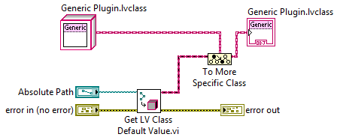

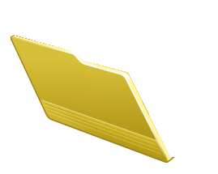
The Basics of an Object Factory
A
B
Objects Loaded Into Memory
C
Generic Measurement
← Parent
Location on Disk
Where Measurements are Stored
A
B
C
← Children
Notes:
We will use a factory pattern to load these plugins (quick recap for people who are unfamiliar)

Slide 20
Demonstration
Dynamically loading new measurements
Notes:
Lets see a couple different ways we can dynamically load a new plugin
Point to it from UI
Modify config file

Slide 21
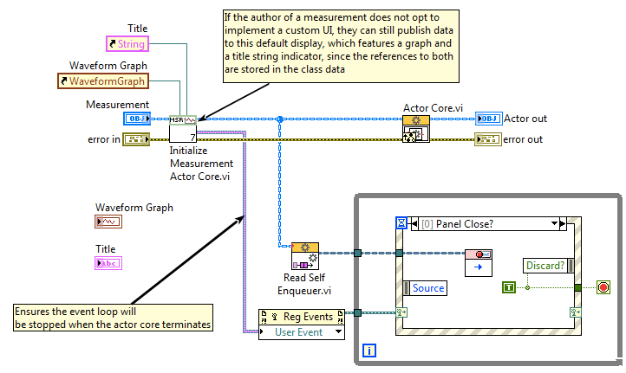
Overriding User Interfaces with AF
Static Init Reference In Base Class
First call: stores references to UI elements and creates user event
Other calls: ignores UI references and returns user event

Slide 22
Measurement System Class Hierarchy
vi.lib
Actor
Common to Application and Plugin
Controller
User Interface
Measurement
Results
Application
Specific
Test Step Controller
Operator UI
Built into Executable
Dynamically Loaded at Run-Time
Plugin
Strain
Resistance
Diode I-V
Frequency Curve
Voltage
Notes:
There’s another important component of this system that we haven’t discussed yet: the hardware. Where and how you abstract in your system is entirely up to you and should be driven by the requirements of your implementation. What you’re looking at here illustrates abstraction at the measurement layer – we have a generic definition of what a measurement can do that we then inherit from to define a concrete implementation. However, assuming measurements interact with real hardware, we also want to mitigate the risk assocaited with introducing a new device or upgrading/migrating etc…

Slide 23
Abstracting Hardware
Actor
Controller
User Interface
Measurement
Measurement
Results
Hardware
Diode I-V
Notes:
So, we also abstract at the hardware layer. We have a generic hardware definition (or class) that is loaded by the controller at run-time, just like the measurements. The hardware device is passed to a measurement at run-time when it requests to run. Keep in mind that one particular measurement may actually request multiple hardware devices for the sake of a stimuli/response measurement.

Slide 24
HW Selected
Validate Selection.vi
Check Validty.vi
Run Pressed
Send Run Rqst.lvclass
Send Run Request
Start Msmt.vi
Launch Msmt Msg.lvclass
Measurement
Hardware
Launch Measurement
Checkout HW.vi
Initialize.vi
Config Msmt Msg.lvclass
Configure.vi
Acquire Msg.lvclass
Acquire.vi
Measure Msg.lvclass
Measure.vi
Send Results Msg.lvclass
Receive Results.vi
Close.vi
Stop Msmt Msg.lvclass
Display Results.vi
Display Results Msg.lvclass
Checkin HW.vi
Notes:
Going back to our sequence diagram, I’ve overlaid some additional info to make this clear. When the controller (in the middle) spins up a measurement, it passes several pieces of data to it, including in this case a hardware object. The acquisition method uses that object to acquire.

Slide 25
Hardware Class Hierarchy
Hardware
Common
Components
Power Supply
DMM
Scope
Generator
Built into Executable
Dynamically Loaded at Run-Time
34401a
HW Plugin
PXI-4110
Simulated
Simulated
PXI 4070
Simulated
PXIe-5185
Simulated
Notes:
Unlike the measurement class, which was just one layer deep, the hardware class actually has an intermediate layer to define certain types of hardware. This way a measurement can request a SCOPE or a DMM, and a user can write the implementation knowing they’ll have a SCOPE or DMM, but without necessarily knowing which exact one. Here again we have plugins, which represent the concrete implementations.

Slide 26
Demonstration
Combining Measurement and Hardware Abstraction Layers

Slide 27
Developing Components Independently
System
Common Components
Msmt Plugin
HW Plugin
Test Step Controller
Controller
Hardware
Measurement Template
Hardware
Template
Operator UI
User Interface
Power Supply
Results Template
Source
Distribution
Executable
Measurement
DMM
Source
Distribution
Installer
Installer
Results
Scope
Installer
Generator
Common
Components
N
N
Notes:
Lets take a look at all the components in our system. One of our goals was to decouple components – to do this, we need to be able to develop components independently of one another, something that is increasingly important as project move towards team-based development.
These represent independent projects – every plugin for both measurements and hardware would likely be contained and developed within a separate LabVIEW project.

Slide 28
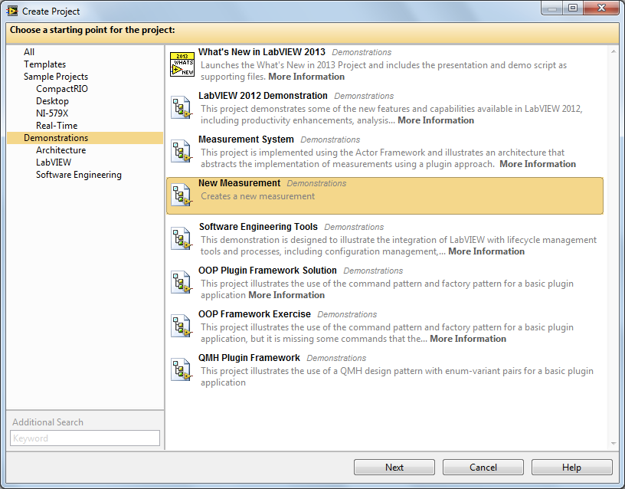
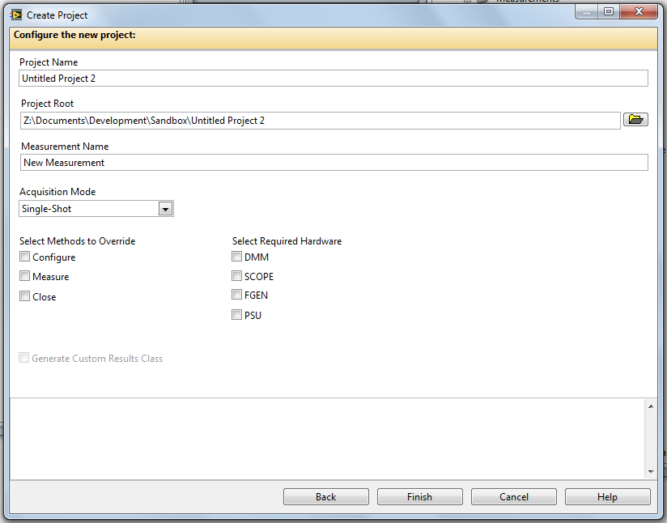
Template Dialog

Slide 29
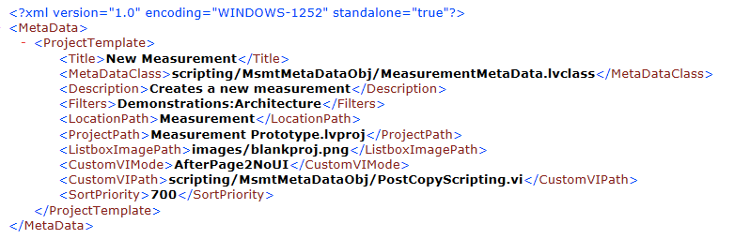
MetaData for Templates

Slide 30
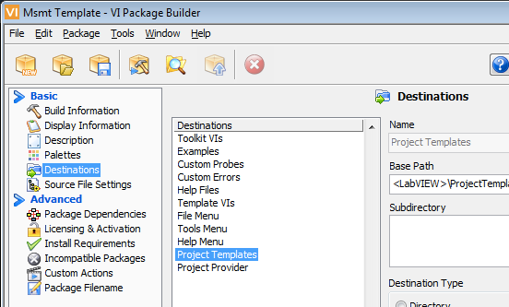
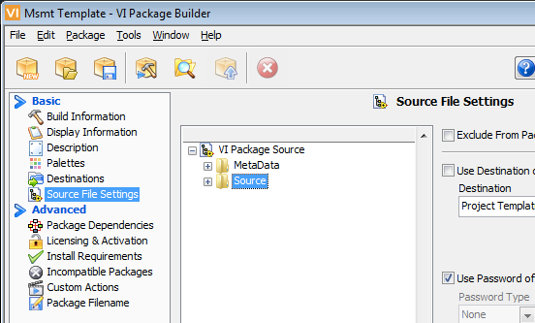
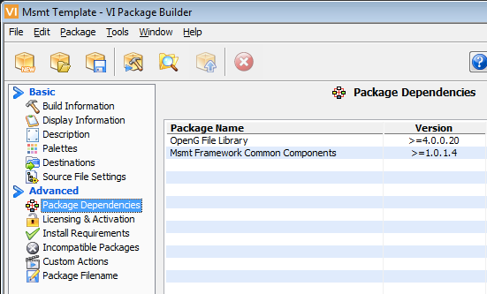
Creating a Template with VIPM

Slide 31
Distribution of Templates
Measurement
Template
Hardware
Template
Depends on
Depends on
Common
Components

Slide 32
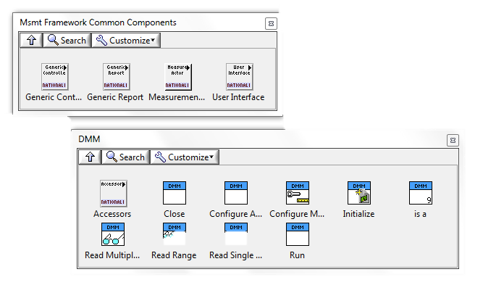
Giving Users Building Blocks
Measurement
Template
Common
Components
Measurement Template
Build
Specifications
Scripting
Code

Slide 33
Demonstration
User Experience When Creating a Plugin
Notes:
Scripting methods
Templatizing Vis
Trick for overriding UIs

Slide 34

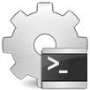
Building an Executable
Startup VI
Create new context for build
Open top-level VI (and any always-included VIs)
Identify statically linked dependencies
Remove unused Vis
Re-compile in new context
Save files to new location
Build into executable
Application-Specific, Statically Linked Code
SubVIs
SubVIs
SubVIs
SubVIs
SubVIs
User-Developed
Re-used
Executable
Library 1
Library 2
vi.lib

Slide 35
Extending Application Functionality
Startup VI
Application-Specific, Statically Linked Code
Dynamically loaded components allow functionality to be changed and even added without modifying or re-building the calling application
SubVIs
SubVIs
SubVIs
SubVIs
SubVIs
Static VI Calls
Dynamic
VI Calls
Dyn Lib A
Dyn Lib N
…
vi.lib
Static VI Calls
Library A
Library B
Notes:
Calls into libraries are not always static – they may be dynamic.

Slide 36
Startup VI
Application-Specific, Statically Linked Code
Dyn Lib A
SubVIs
SubVIs
SubVIs
SubVIs
SubVIs
Static VI Calls
Library A
Library B
LabVIEW
Development Environment
Run-Time Engine
Loaded at run-time
Looking for Library B
Executable
Library B

Slide 37
Loading Dependencies in the Run-Time
Executable
Dynamically loaded components need to be able to find their dependencies in memory in order to run.
The run-time engine will look in:
The executable
Default search paths
Custom search paths
Hardware Plugins
Measurements
Instr.lib
NI-DAQmx
AAL
Actor Framework
Notes:
When an executable is loaded, it brings all of the VIs contained within it into memory. The same occurs as it loads dynamically called components. It looks for VIs by name, and only one VI per namespace can be loaded into memory at a time – as a result, if a dynamically called component contains a VI that is already in memory (either because it was within the exe or another loaded component), then it will not be brought into memory.
If it can’t find a required VI, it will go looking for it.
The order of places it will look for it is dictated by search paths.

Slide 38
You Have Two Options
Transport dependencies with the executable
Cannot remove unused components (because you don’t know what won’t be used)
Minimizes size of plugins
No possibility of duplicate dependencies
Upgrading dependencies requires rebuilding executable*
Transport dependencies with the plugin
Allows you to remove unused components to minimize disk footprint
New versions of dependencies can be transported with plugin
Risk of duplicate dependencies on disk
Can’t be sure which version will be loaded into memory
*unless they’re built outside the EXE, such as a DLL or PPL

Slide 39
Identifying Components Outside the EXE
Executable
Strain
Resistance
Diode I-V
Frequency
Sound and Vibration
OpenG Libraries
Advanced Analysis
Actor Framework
Notes:
Perhaps one of the biggest challenges when it comes to loading components outside of the exe is ensuring that all of the necessary dependencies are loaded into memory. Many people don’t realize that the run-time engine does not, by default, include the same paths and resources that are included within the development environment, including vi.lib, instr.lib and user.lib. Without careful consideration of how and when these resources are made available to these components, your application will not run and you may (depending upon how you’re loading components) be prompted for missing files.
This is a challenge that is universal across all development environments and languages, especially when building a plugin model that can load and run an unlimited number of plugins, as these items may share dependencies.
In the example of this system, we have four different measurements that we will dynamically load into our system at run-time, the circles indicate the extent of the library that they’re using, as one of these components may not need all of the VIs in a larger library. Take AAL (Advanced Analysis Library) – this library is huge, as it contains a large majority of the math and signal processing routines available for use in LabVIEW. Reproducing this entire library for each of these components would quickly add up to a significant amount of disk space (several GBs). When built into an exe, we normally take only the components we need, as indicated (to the compiler), by the items to which we are statically linked.
However, if another plugin needs some VIs from AAL, but it’s not the same subset, this can be a problem. We either have to choose to put the entire AAL in the executable or distribute the components each plugin needs with the plugin (which creates duplicate items on disk).
In this example, every plugin needs all of the Actor Framework, so we can safely build that into the executable and tell App Builder to include all of the components.

Slide 40
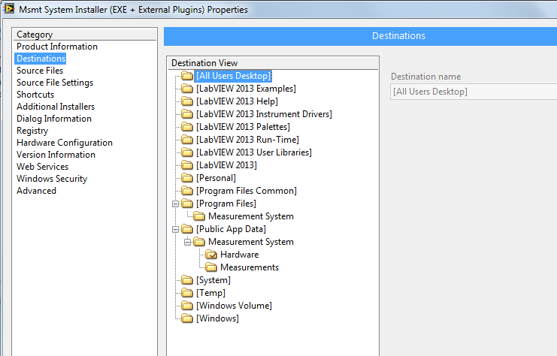
Destination for ‘Plugins’

Slide 41
Demonstration
Installing a Plugin
Notes:
Lets see a couple different ways we can dynamically load a new plugin
Point to it from UI
Modify config file

Slide 42
Next Steps: Packed Project Libraries Distribute and Deploy LabVIEW Libraries as a Single File
Development Environment
Deployed System
VI
VI
VI
Callers
VI
VI
VI
Callers
lvlib
Project Library
Packed Project Library
VI
VI
VI
VI
Public API
VI
VI
VI
VI
Public API
Compiled
code
Private VIs
Decrease build times
Deploy the VI hierarchy with a single file
Simplified code deployment

Slide 43
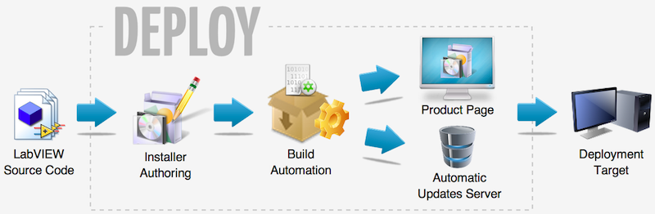
Next Step: Deploy and Distribute Setup Authoring & Application Distribution Add-On for LabVIEW
Automate time-consuming tasks to deliver professional software:
Inclusion of third-party drivers and run-time engines
Includes Amazon Cloud hosting services*
Minimize download footprint by silently downloading dependencies
Single click install for customers
In product update notifications
*Deploy can use other services, including local and private servers
Notes:
Main Message: Deploy is a LabVIEW add-on, accessible with LabVIEW 2013, which automates many of the time consuming tasks involved in distributing LabVIEW-built applications. This add-on is accessible on the LabVIEW tools network.

Slide 44
Summary
Highly-extensible architectures necessitate the use of object-oriented programming
Plugin based approaches require significant investment in architecture and planning
VI Package Manager can be used to distribute common components, templates and APIs

Slide 45
Thank You
bit.ly/lv_oomal
ekerry.wordpress.com

